Slide 1
Library Management system

Slide 2
Title: Library Management System
Problem Statement: Managing books manually is time-consuming and error-prone. This system automates borrowing, returning, and tracking books efficiently.
Target Users: Library staff, students, and library members

Slide 3
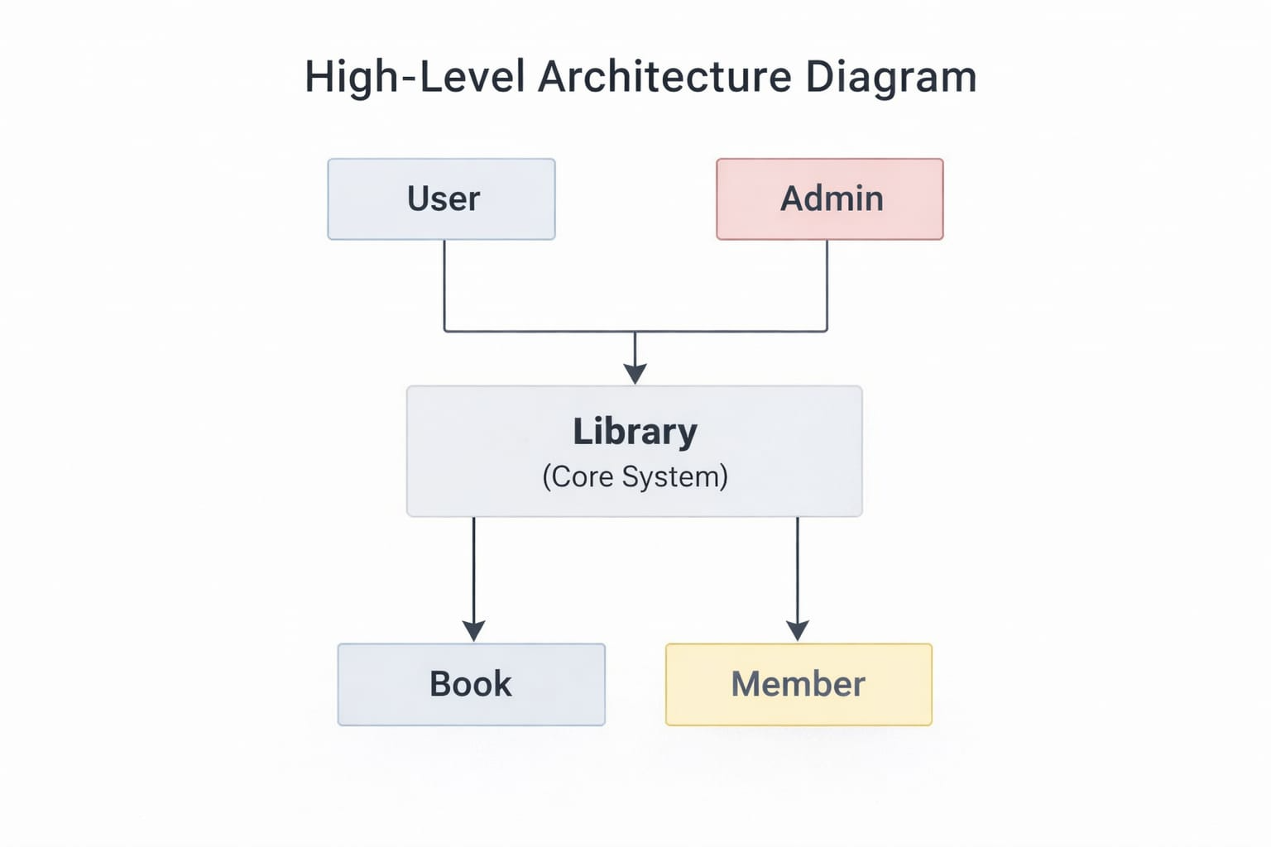
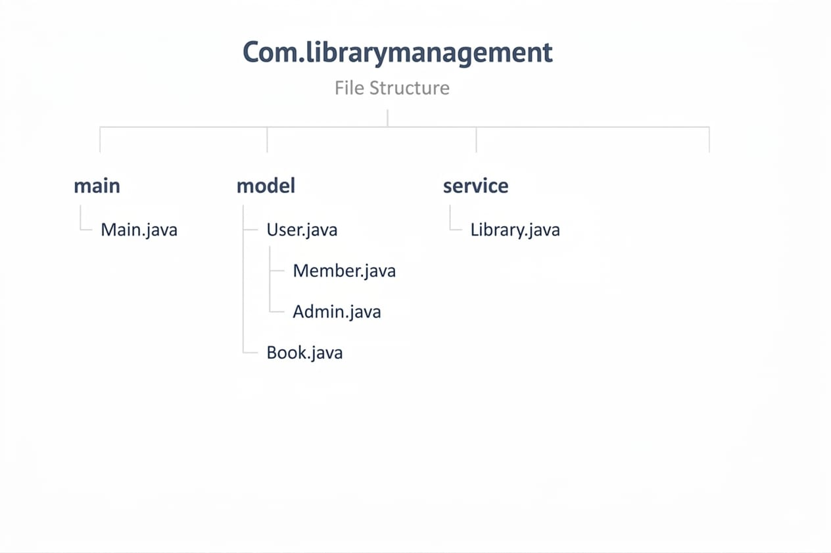
System Design
Key Classes & Responsibilities:
Book: Stores book details and availability
Member: Handles member info and borrowing/returning
Library: Manages collection of books and system operations
User/Admin: Inherits User, Admin performs additional tasks
Package Structure

Slide 4
OOP Concepts Used
Abstraction: User inputs handled via Library class, hiding internal details
Inheritance: Admin class extends User class
Polymorphism: Overriding methods in Admin for admin-specific actions
Encapsulation: Private fields with getters/setters in Book, Member, User

Slide 5
Technical Highlight
Specific Design Decision / Code Logic:
Used isAvailable flag in Book class to track whether a book can be borrowed
Implemented borrowBook() and returnBook() methods to update book status
Used search logic with contains() and toLowerCase() for flexible title matching
Implemented menu-driven system using switch-case for user interaction
Why Chosen:
isAvailable ensures no duplicate borrowing of the same book
Separate methods for borrow/return improve modularity and code clarity
Flexible search allows users to find books even with partial or case-insensitive input
Menu-driven approach provides simple and user-friendly interaction

Slide 6
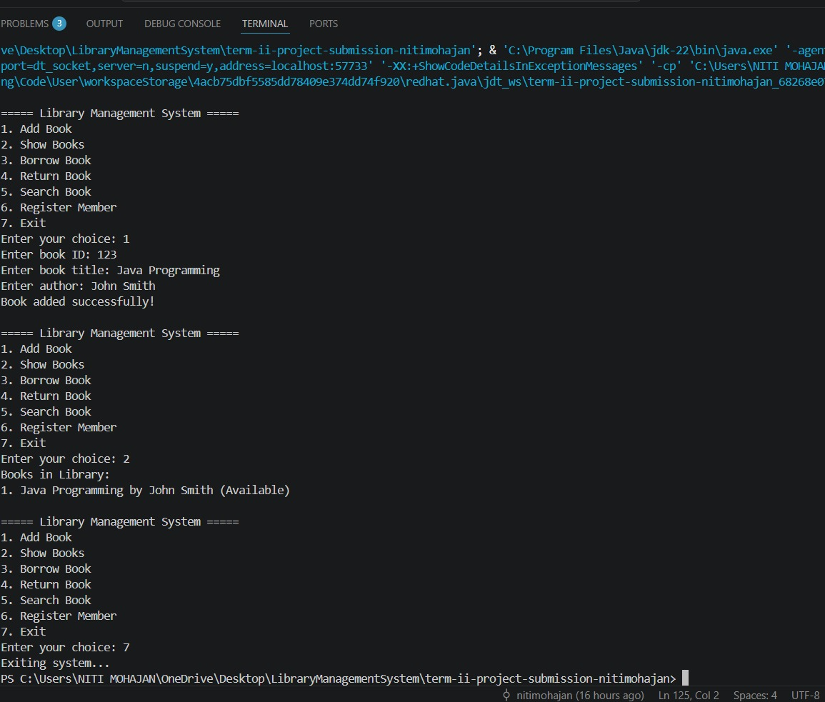
Adding a new book to system

Slide 7
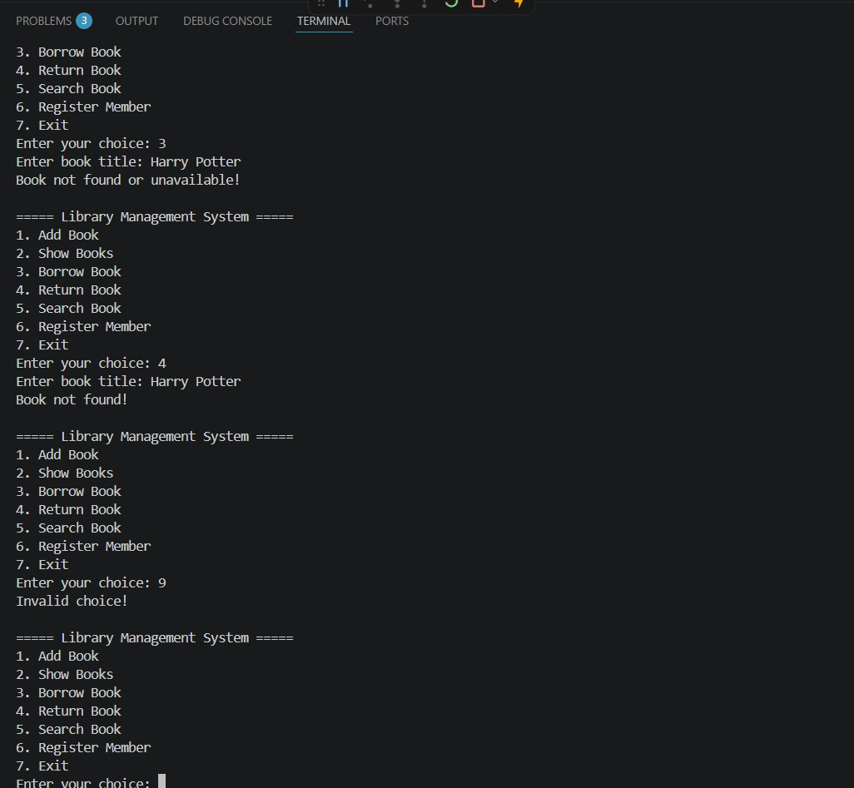
Error Handling Cases
implemented validation
checks to ensure the
System handles incorrect
inputs gracefully
without crashing.

